Slide 1
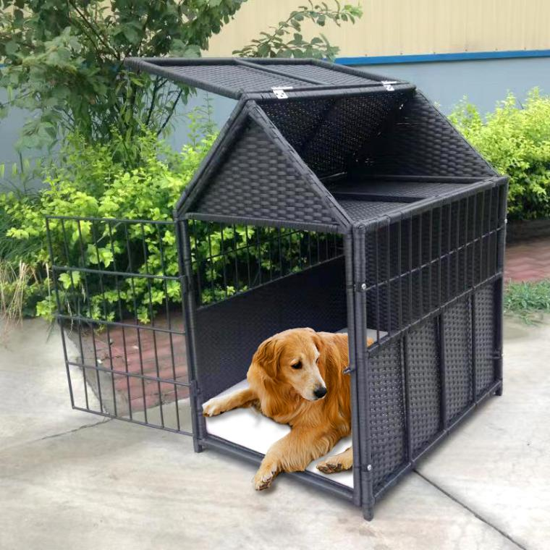
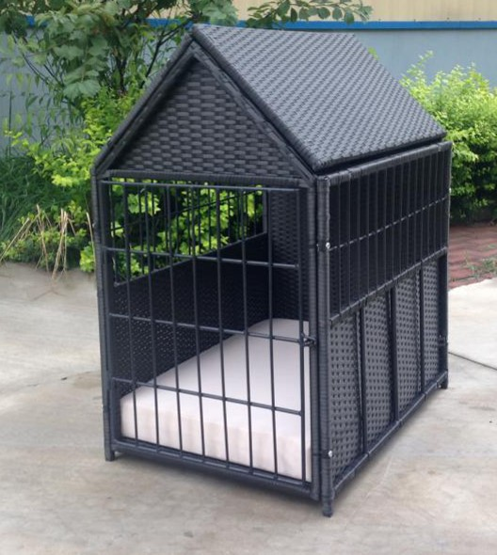
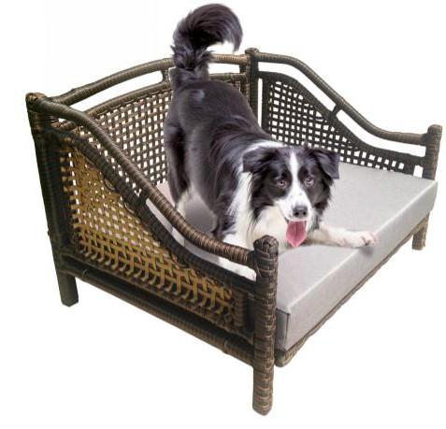
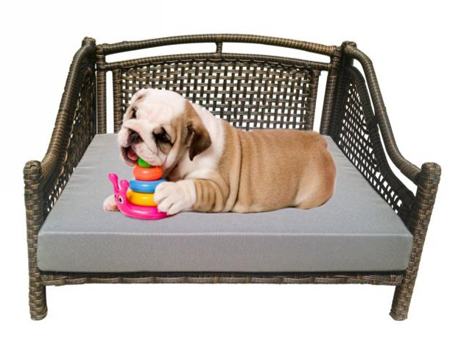
Your Yard, Your Dream!
BF-P056 RATTAN DOG HOUSE WITH DOOR AND ROOF
Boomfortune weave your dream home by hands！
BF-P062 RATTAN DOG BED, UNIQUE WEAVING PATTERN
LET'S PLAY TOGETHER

Slide 2
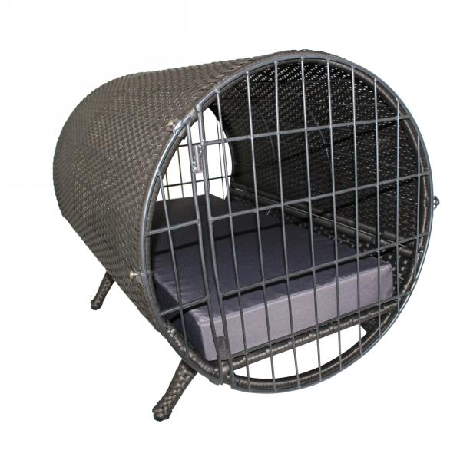
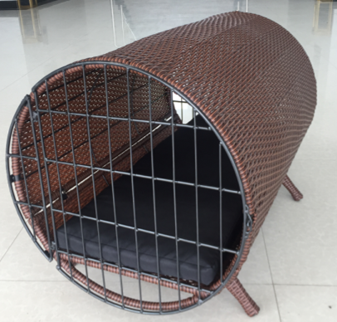
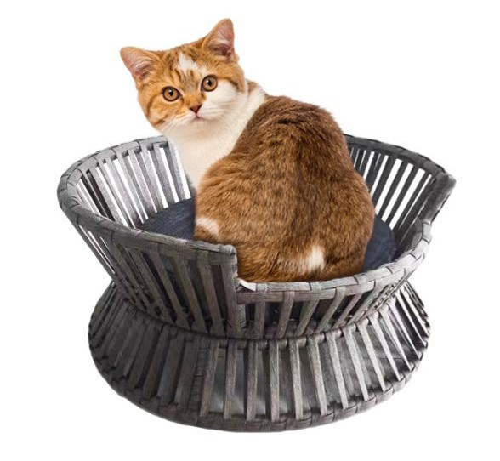
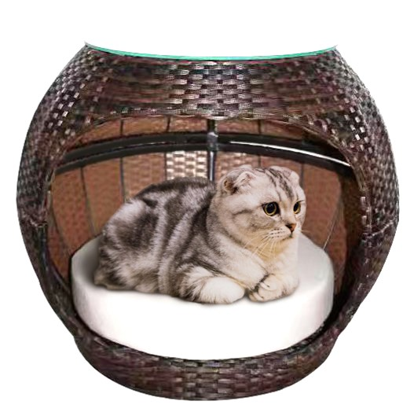
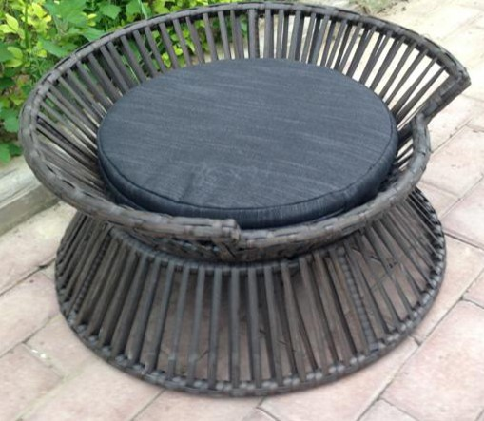
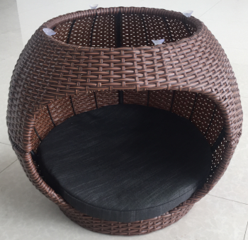
BF-P058 CYLINDER RATTAN PET BED
Your Yard, Your Dream!
Pet Furniture
BF-P059
WAIST SHAPE
PET SOFA
BF-P057
DRUM SHAPE RATTAN WOVEN PET BED

Slide 3
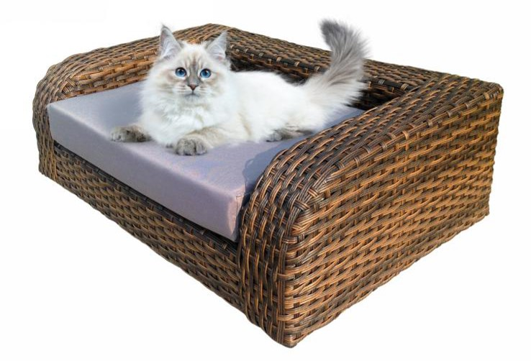
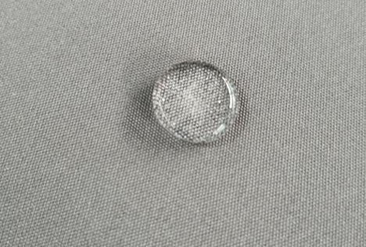
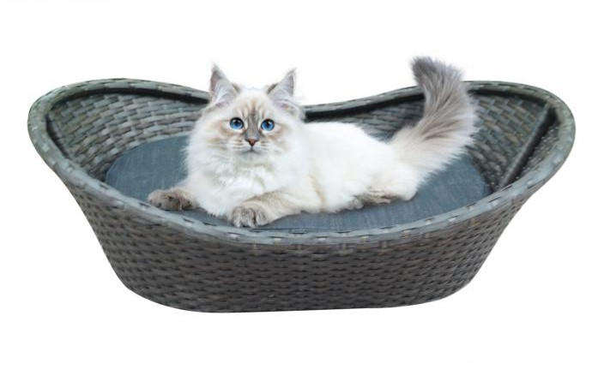
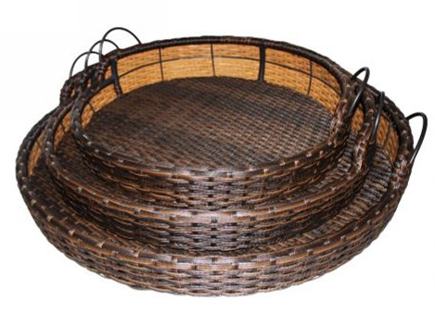
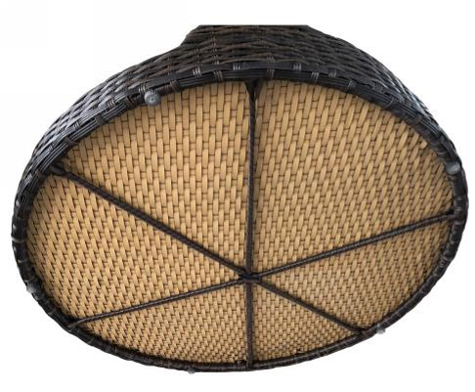
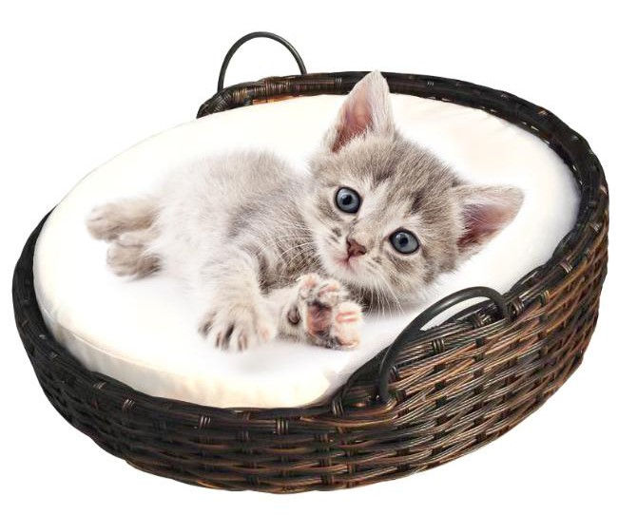
Your Yard, Your Dream!
WATERPROOF CUSHION COVERS FOR ALL PET SOFA BED
BF-P049 RATTAN WOVEN WHOLE PET BED
BF-P050 BOAT SHAPE RATTAN PET BED
BF-P046
PET SOFA BED WITH HANDLES, STACKABLE WITH DIFFERENT SIZES, RATTAN CORDS UNDERNEATH FOR STRONG SUPPORT;
Pet Furniture

Slide 4
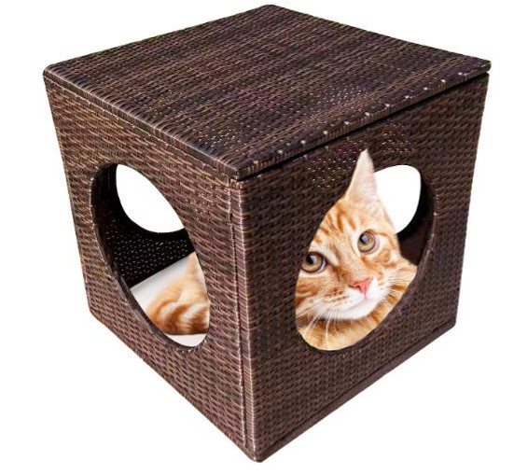
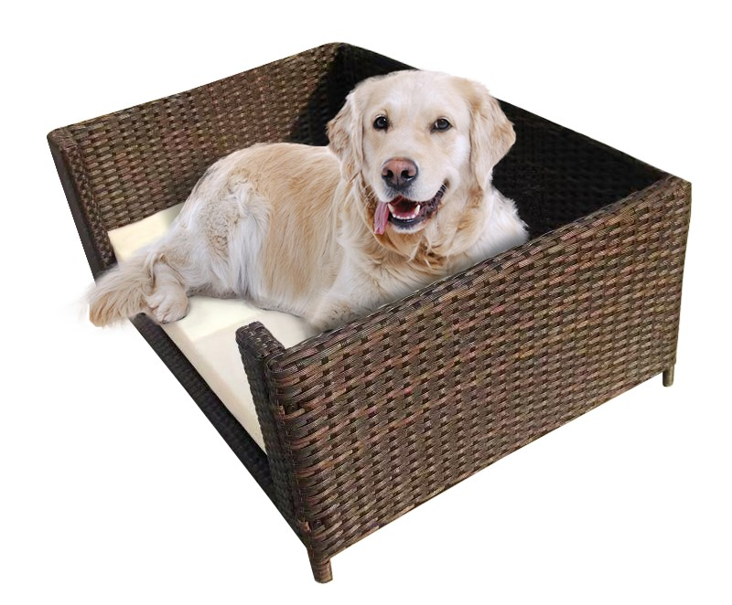
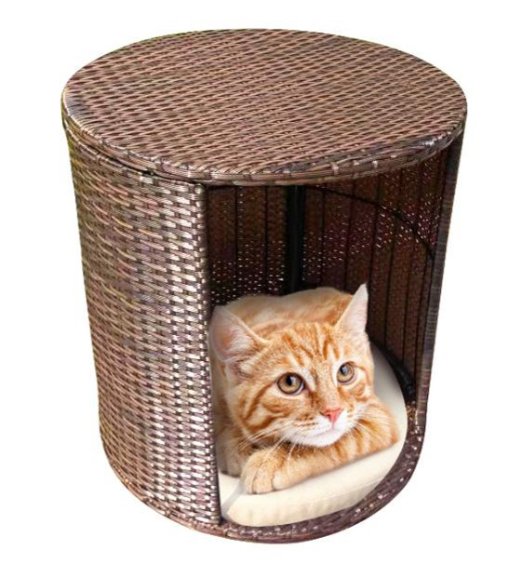
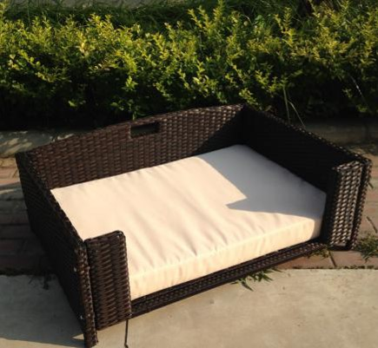
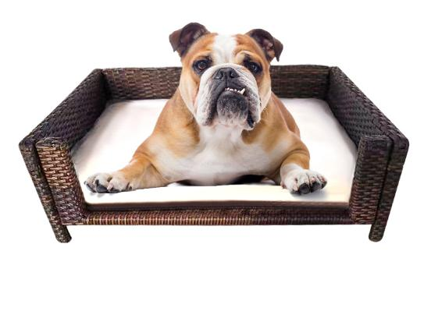
Your Yard, Your Dream!
BF-P061 KD RECT. DOG BED W/CUSHION
BF-PCT052 CUBIC RATTAN PET BED
BF-PCT053 RATTAN WOVEN LAZY CAT BED

